Slide 1
BDT Project Presentation on Weather analysis
From: anil Maharjan
Supervisor: Prof. Mrudula Mukadam
Link for the video presentation:
https://web.microsoftstream.com/video/9d697966-ef89-412c-9c99-37fd57b2d16d

Slide 2
Project summary
The project is designed for analyzing the weather.
Continuous stream of whether data is generate using the weather api
Used API:
https://api.openweathermap.org/data/2.5/weather?zip={zip code},{country code}&appid={API key}
The continuous stream is sent via Kafka channel
Continuous is then consumed by Kafka Consumer. Spark is used for consuming and processing the data. The processed data is then saved into HBASE
For analysis, spark is used to scan the data from HBASE and performed some basis analysis like
Count the min lowest temperature, maximum lowest temperature, average minimum temperature by CityWise
The analyzed report is then save into HDFS in csv format for further analysis which can then be performed by tooks like PowerBI, Tableau, and so on

Slide 3
Technologies used
Technologies
JAVA 11 and above
Kafka
Spark
HBASE
Eclipse
API
https://api.openweathermap.org/data/2.5/weather?zip={zip code},{country code}&appid={API key}
{zip code} = zip code of the city
{country code} = like us
{API Key} = key used that is generate after registering for the free account

Slide 4
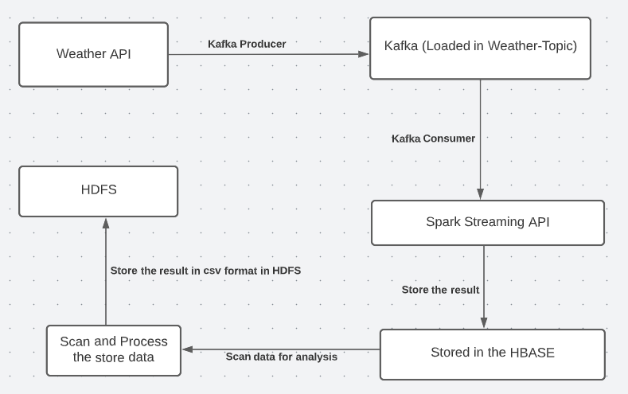
Project flow

Slide 5
Module overview: Streaming api
https://api.openweathermap.org/data/2.5/weather?zip={zip code},{country code}&appid={API key}
{zip code} = zip code of the city
{country code} = like us
{API Key} = key used that is generate after registering for the free account
Example https://api.openweathermap.org/data/2.5/weather?zip=52556,us&appid=f03bdb7bce99b2b7956999c7a168e7a4

Slide 6
Information extracted from api
"coord": {
"lon": -91.9576,
"lat": 41.0039
},
"main": {
"temp": 290.18,
"feels_like": 289.19,
"temp_min": 289.12,
"temp_max": 291.07,
"pressure": 1019,
"humidity": 48
},
"name": "Fairfield",
Date

Slide 7
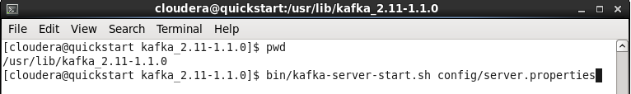
Run the kafka server

Slide 8
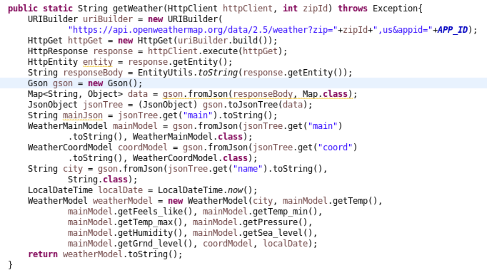
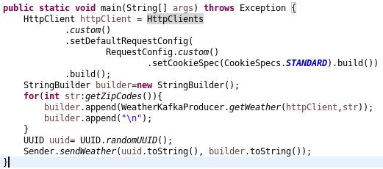
Kafka producer: WeatherKafkaProducer
Step 1: Create HttpClient to read the API
Step 2: Prepare ZipCode for bulk insert
Step 3: Create the connection to Kafka and push into topic

Slide 9
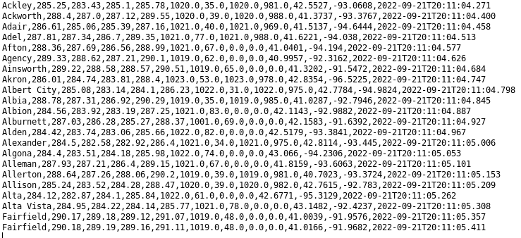
Sample data generate by kafka producer

Slide 10
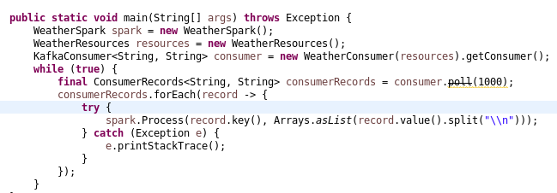
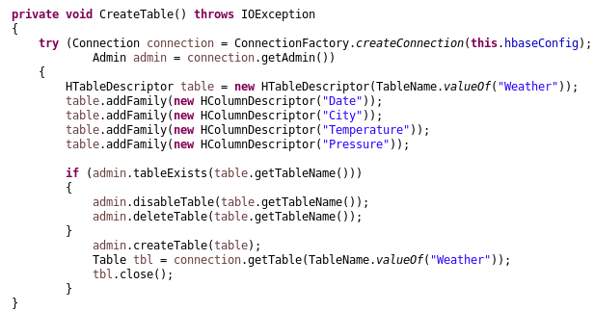
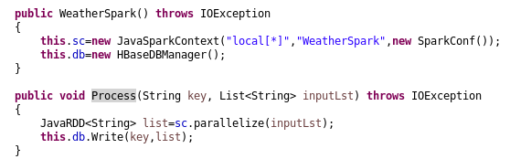
Kafka consumer: SparkConsumer
Create the Spark Connection
Create the Weather model
Consume the Kafka topic
Push the records into HBASE using Spark

Slide 11
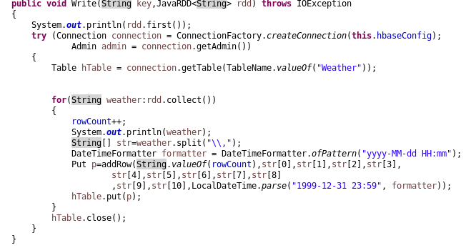
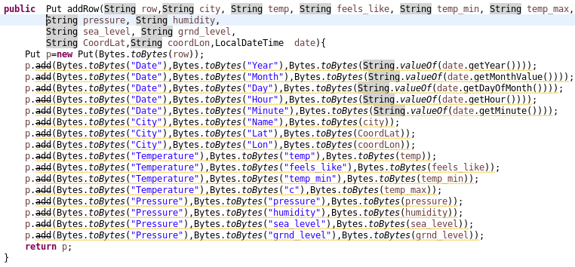
Kafka consumer cont…

Slide 12
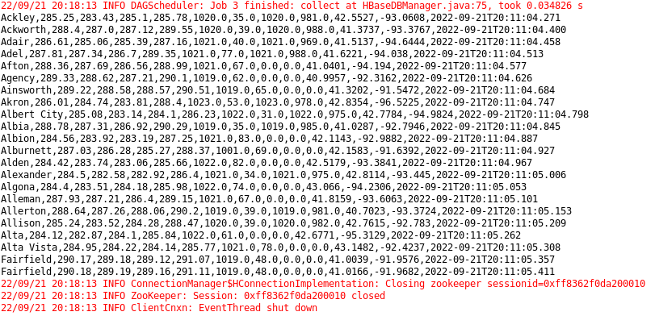
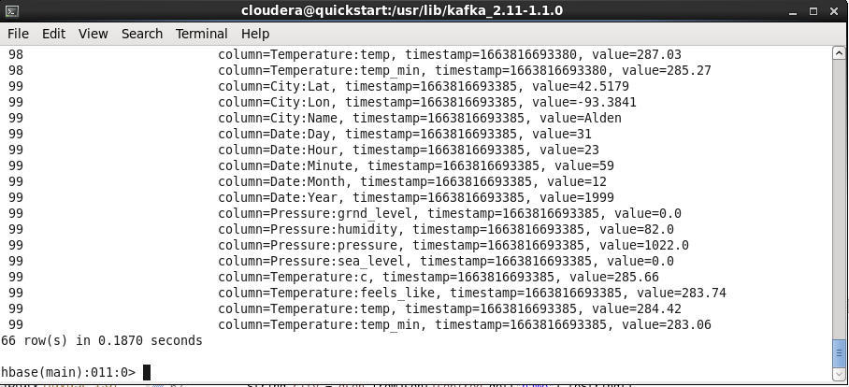
Kafka consumer - output

Slide 13
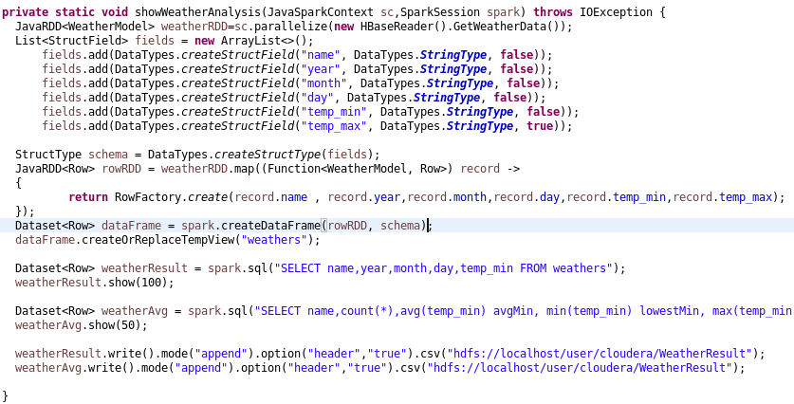
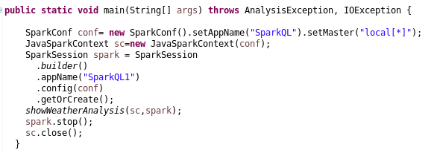
Spark Query Language: sparkql
Step 1: Create SparkSession
Step 2: Read Weather Data
Step 3: Create the Dataset
Step 4: Analyze the dataset
Step 5: Generate output in csv
Step 6: Save result in HDFS

Slide 14
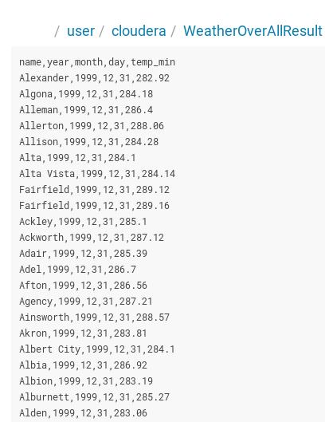
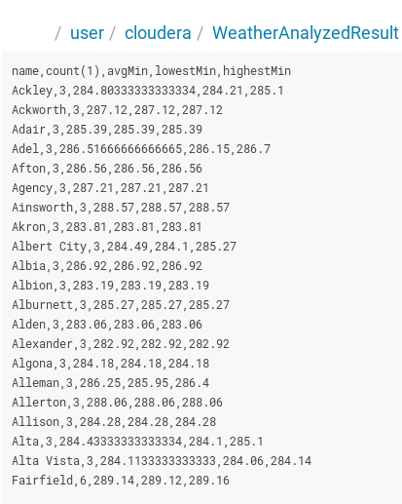
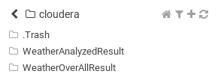
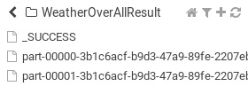
SPARKQL: cont…

Slide 15
Thank you…

